Slide 1


ISO/IEC 27001:2023 Security Audit
Organization: Cyberzone AI Ltd
Audit Date: 29/10/2025
Audit Performed By:
Sylvester Tarus
Md Mahmudul Hasan Tuhin
Audit Version: V1

Slide 2



Introduction
Cyberzone AI Ltd is a technology start-up company that specializes in developing and providing AI-powered decision-making systems for Fintech and Healthcare sectors across the UK and United States of America.
Cyberzone AI Ltd, recently experienced a major cybersecurity incident which led to the compromise of its internal network leading to unauthorized access of internal systems through lateral movement techniques, leakage of pre-trained AI models as well as customer datasets. It was also noted that the attackers exported source code repositories to unknown IP addresses, leading to major compliance, financial and reputational risk to the organization.

Slide 3
Objectives
Objectives
Evaluate the effectiveness of Cyberzone AI Ltd current administrative, technical and physical security controls in the hybrid cloud environment
identify non-conformities in the organization’s processes.
Recommend strategies that could help mitigate future cyber-attacks, ensure the organization complies with relevant regulatory bodies and improve on the overall security posture of the organization.

Slide 4
Audit Scope
Technical infrastructure-The audit will cover all Cyber AI Ltd’s IT infrastructure components both on-premises and the azure cloud environment
Security control and policies-The audit will review the administrative as well as operational controls that govern the organization’s security practices.
Data and asset protection-The specific area of focus is on data handling, data leakage analysis, AI model security and protection of source code.
20 critical assets were selected for the audit(CZ001-CZ020)

Slide 5
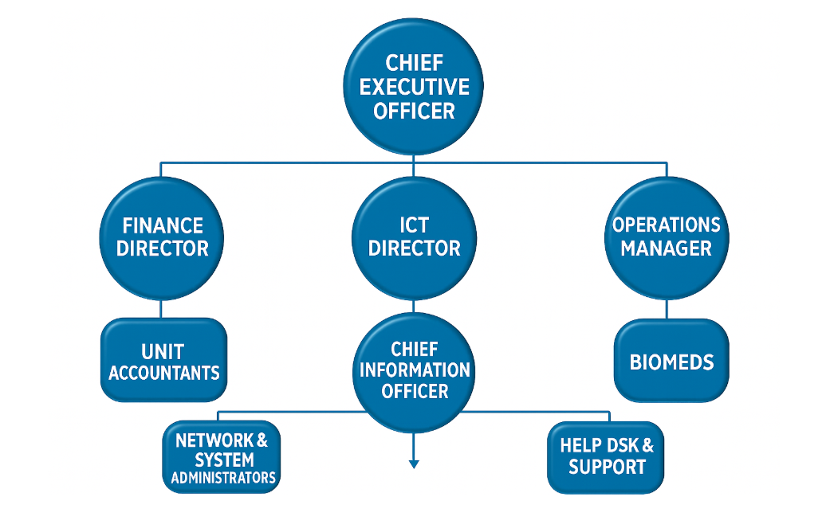
Organization Structure

Slide 6
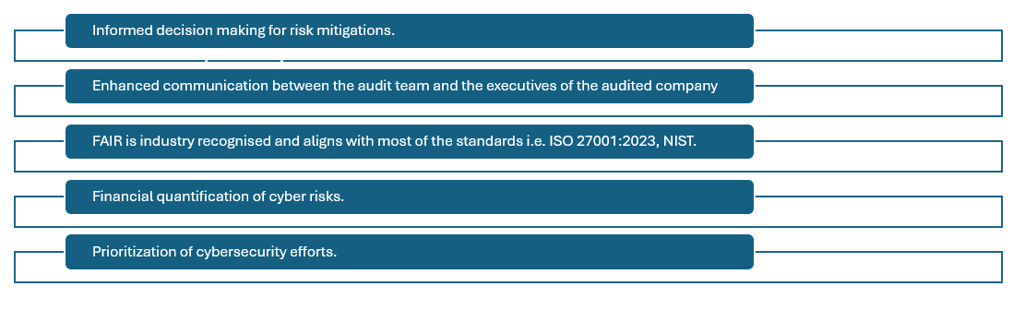
Methodology
FAIR Risk Assessment Methodology
Data sources:
Interviews & observations
Security incidents
System logs & audit trails
Policies & procedures
Training records
FAIR components
Threat Event Frequency
Threat Capability
Control Strength
Probable Loss Magnitude
Loss Event Frequency
Vulnerability
Worst Case Scenario
Methodology Justification

Slide 7
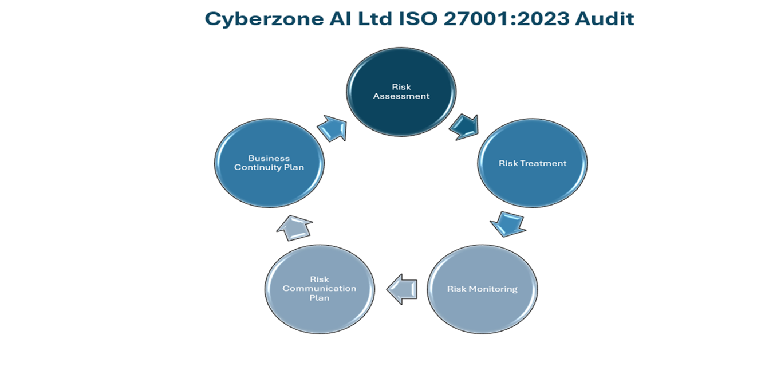
Audit Workflow

Slide 8
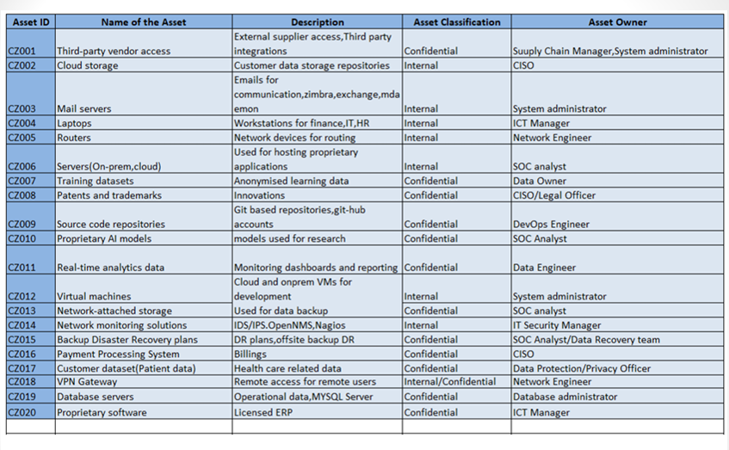
Asset identification & Justification

Slide 9
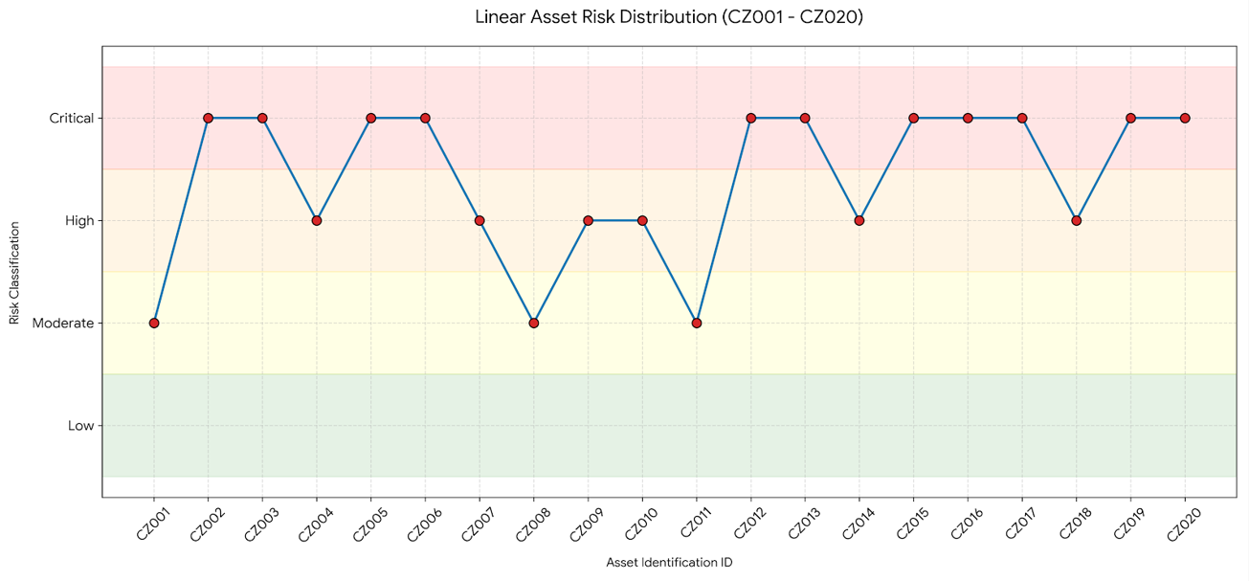
Risk Assessment
1: Overall Risk Value

Slide 10
2:Key findings(Vulnerabilities/Threats)
Overall Compliance Summary
Cyberzone AI Ltd is partially compliant with ISO/IEC 27001:2023
Although ISMS exists, there is lack of enforcement.
Non-Conformities (NCs)
Major:
Shared administrator accounts/default passwords
Inadequate patch management plan
Incomplete back up disaster recovery plan
Minor:
Weak supplier security agreement.
Inconsistent implementation of cryptographic controls.
Inconsistent training records
Opportunities for Improvement (OFIs)
Governance maturity improvement
Enhance third-party risk management
Consistent and effective monitoring

Slide 11
Risk Assessment & Treatment Linkage
Link Between Non-Conformities / Opportunities for improvements and Risks
Nonconformities directly increased likelihood and impact of cyber risks
Opportunities for Improvement indicate areas of low security maturity
Identification of critical risks
Data and pre-trained AI model exfiltration
Unauthorized lateral movement
Regulatory non-compliance/contractual/legal obligation
Service disruption through DDOS
FAIR Analysis Outcome
Threat Capability > Control Strength
Existing controls unable to resist attacker capability

Slide 12
Statement of Applicability(SoA)
ISO/IEC 27001:2023 Annex A controls reviewed
Controls categorized as:
Applicable
Partially applicable
Excluded (with justification)
Control selection based on:
Risk severity
Asset criticality
Legal and contractual obligations
Ensures traceability:
Risk → Control → Treatment

Slide 13
Action & Improvement/Risk Treatment
Risk Treatment Approach
Risk reduction (main strategy)
Risk transfer (cloud and suppliers)
Limited risk acceptance (low-impact risks)
Key Improvement Actions
Improve on access controls(MFA and role-based)
Network segmentation and security hardening
Improve SIEM and continuous monitoring/logging
Data encryption for sensitive data and AI models
Regular security drills(back up recovery)

Slide 14
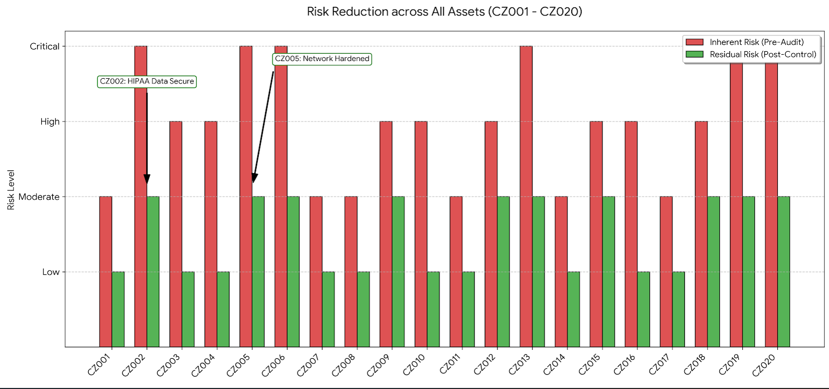
Post-treatment

Slide 15
Risk Reduction Impact
Reduced likelihood of threat.
Potential reduction in financial and operation cost.
Timely detection and response times for security incidences
Improved system availability and resilience
Residual risks reduced to acceptable levels(risk appetite)

Slide 16
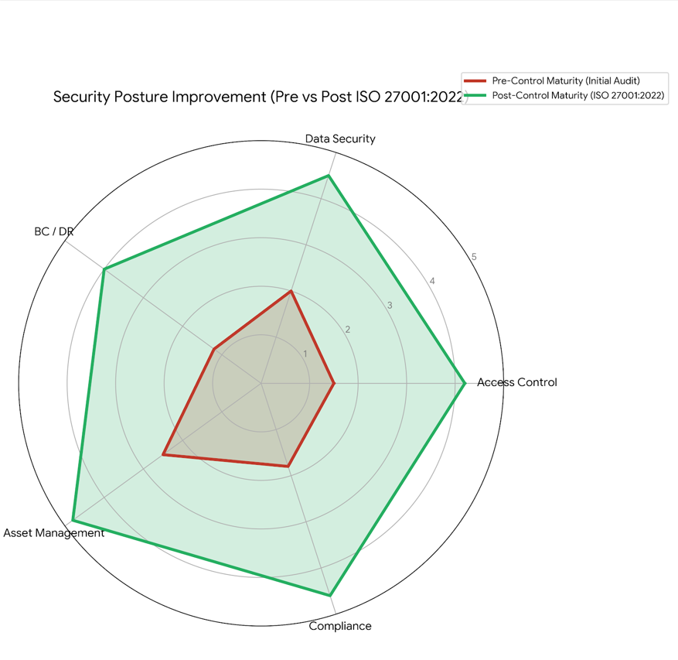
Pre-treatment vs Post-treatment

Slide 17
Risk Communication and Monitoring
Risk Communication
Defined escalation paths
Reporting based on risk severity
Communication to SOC, CISO, and management
Risk Monitoring
Continuous monitoring using:
SIEM dashboards
Cloud security tools
Key Risk Indicators (KRIs)
Supports continuous ISMS improvement

Slide 18
Remediation-ISO Compliance
ISO 27001:2023-Aligned Remediation
01
02
Identity Governance
Strengthen identity access management and implement multifactor authentication across all critical systems
Cloud Security
Improve segmentation and cloud governance controls(Azure and AWS)
03
04
Data Protection
Encrypt pre-trained AI models and sensitive data at rest and in transit
Detection & Response
Enhance SIEM monitoring, alerting, and DR testing

Slide 19
Regulatory, Legal &Contractual Obligation
Obligation
GDPR & UK Data Protection Act 2018
HIPAA (healthcare data protection)
PCI DSS (payment systems)
ISO/IEC 27001 compliance requirements
Focus Areas
Data confidentiality, integrity, availability
Breach detection and reporting
Contractual security obligations

Slide 20
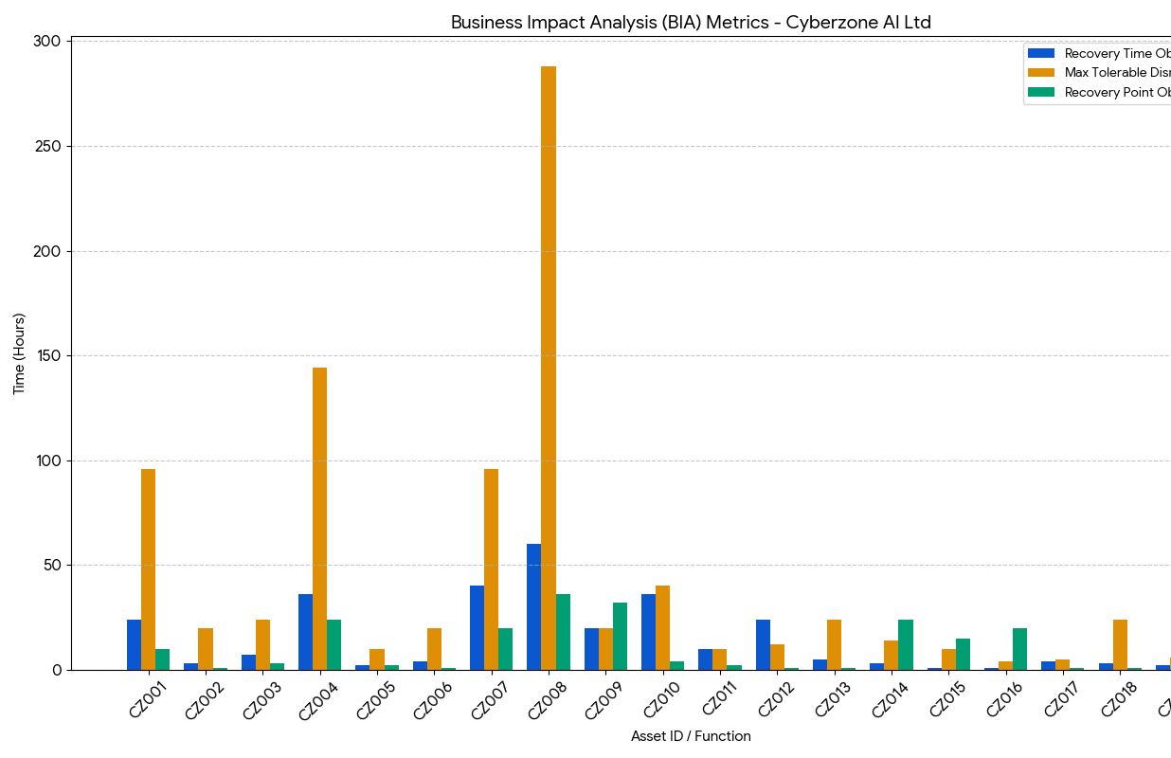
Business Continuity & Disaster Recovery
Business Impact Analysis
Business Continuity& Disaster Recovery Strategy
Most Stringent Requirents:CZ002 and CZ0005
Data Sensitivity:CZ002
Operational resilience:RTO vs MTPD(asset CZ001 which has an RTO of 24 hours against an MTPD of 4 days)

Slide 21
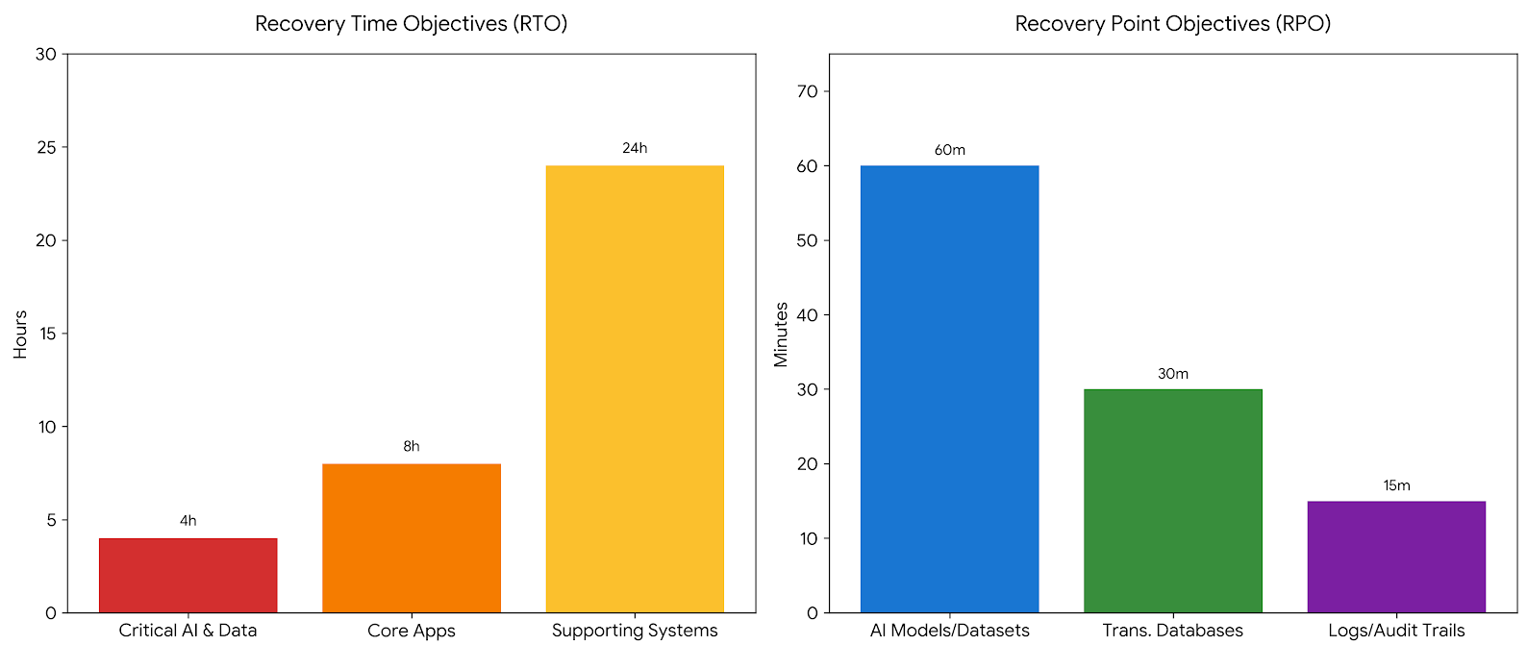
Disaster Recovery Strategy
Recovery Time Objectives
4- hour return to service window for Critical AI services is anticipated while systems that support business operations can have a broader 24-hour recovery period
Recovery Point Objectives
Strictest requirement -Audit trail and logs with 15-minutes RPO to ensure forensic integrity followed by Databases and Proprietary AI models with 1-hour RPO

Slide 22
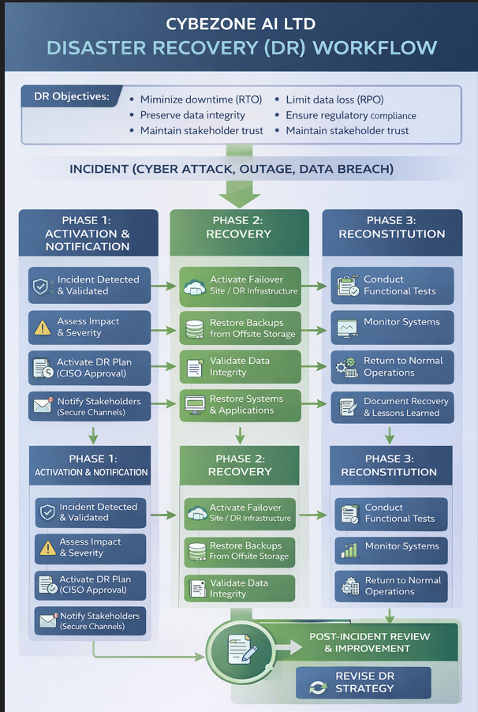
Disaster Recovery Workflow

Slide 23

Conclusion
Overall Security Posture, Conclusion & Recommendations
Overall Security Posture
Shift from reactive to proactive IT security
Stronger governance and controls(ISO 27001:2023,DPA,2019,GDRC,HIPAA)
Adequate monitoring and documentation of residual risks.
Residual Risk & Impact
It is impossible to eliminate all risks. Some risks remain due to operational and financial constraints.
Residual risks are within Cyberzone AI Ltd acceptable risk appetite
Conclusions & Recommendations
Risks to remain within acceptable thresholds.
Regular audit and assessments(SLA with audit firm).
Continuous user awareness training on IT security(seminars,worshops,bytes).
Ongoing ISMS improvements through control tightening.

